Slide 1
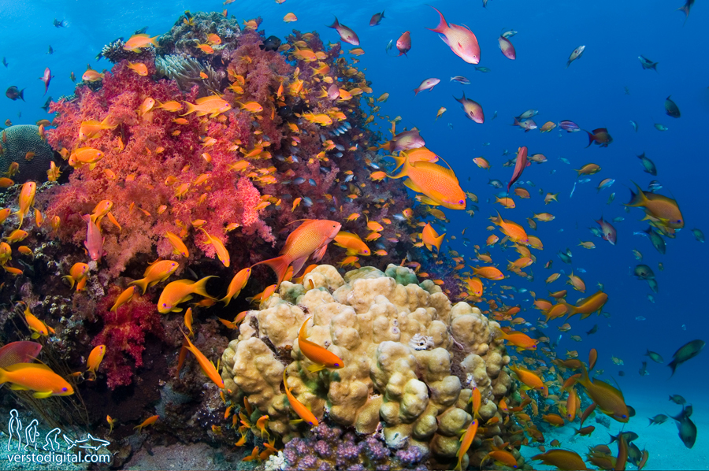
GREAT BARRIER REEF - OBJECT DETECTION MODEL
Data Mining M Project
20-09-2023
De Cecco Jasmin

Slide 2
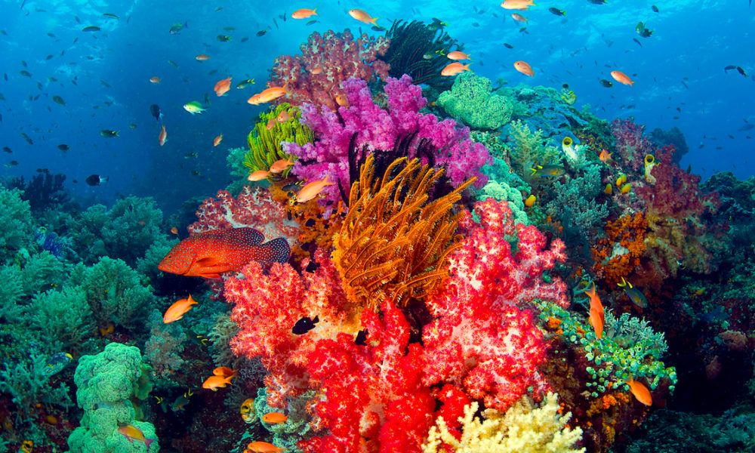
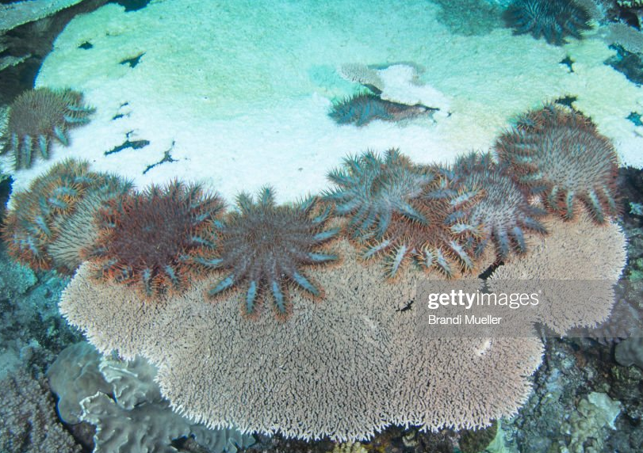
INTRODUCTION
Australia's beautiful Great Barrier Reef is the world’s largest coral reef with:
1,500 species of fish
400 species of corals
130 species of sharks
Rays
and a massive variety of other sea life.
Unfortunately, the reef is under threat, in part because of the overpopulation of one particular starfish:
the coral-eating crown-of-thorns starfish (or COTS for short).
Scientists, tourism operators and reef managers established a large-scale intervention program to control COTS outbreaks to ecologically sustainable levels.

Slide 3
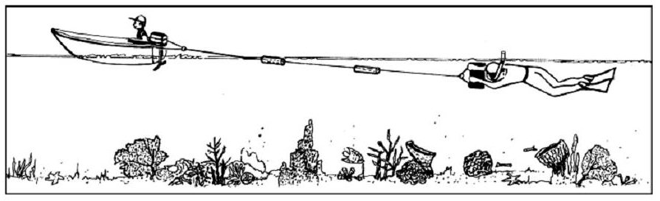
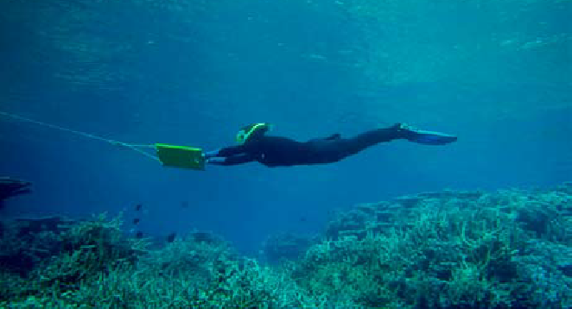
GOAL & REASONS
"Manta Tow“: traditional reef survey method performed
by a snorkel diver to map COTS.
Effective but with some limitations:
operational scalability
data resolution
Reliability
traceability
The Great Barrier Reef Foundation established an innovation program to improve COTS Control exploiting AI strengths.
Australia’s national science agency, CSIRO has teamed up with Google to develop innovative machine learning technology.
Goal: object detection model model trained on underwater videos of coral reefs in order to identify starfish in real-time .
With a system that can analyse large image datasets accurately, efficiently, and in near real-time researchers will improve their work.
BUOY
UNDERWATER DIGITAL CAMERA/VIDEO
Notes:
a traditional reef survey method, called "Manta Tow", is performed by a snorkel diver to map COTS. While towed by a boat, they visually assess the reef, stopping to record variables observed every 200m. While generally effective, this method faces clear limitations, including operational scalability, data resolution, reliability, and traceability
The Great Barrier Reef Foundation established an innovation program to improve COTS Control: underwater cameras will collect thousands of reef images and AI technology could drastically improve the efficiency
To scale up video-based surveying systems, Australia’s national science agency, CSIRO has teamed up with Google to develop innovative machine learning technology that can analyse large image datasets accurately, efficiently, and in near real-time
build an object detection model trained on underwater videos of coral reefs in order to identify starfish in real-time and help researchers protecting the reef for future generations.

Slide 4
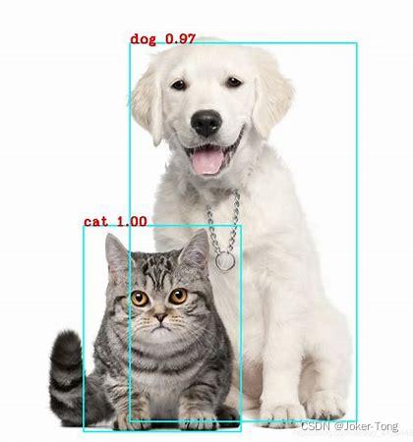
OBJECT DETECTION MODEL
Input:
sequences of underwater images taken at various times and locations around the Great Barrier Reef
Output:
prediction of presence and position of crown-of-thorns starfish as bounding box with a confidence score for each identified starfish.
NOTE
The model won’t be applied on a test set since it is part of a competition that uses a hidden test set available only once the notebook is submitted and scored.

Slide 5
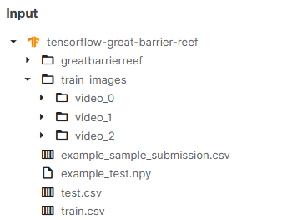
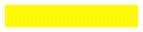
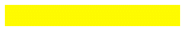

INPUT DATA
train_images/
Folder containing training set photos of the form video_{video_id}/{video_frame_number}.jpg.
train.csv , test.csv
Metadata for the images. As with other test files, most of the test metadata data is only available to your notebook upon submission
example_sample_submission.csv
A sample submission file in the correct format. The actual sample submission will be provided by the API; this is only provided to illustrate how to properly format predictions.
example_test.npy
Sample data that will be served by the example API.
greatbarrierreef
The image delivery API that will serve the test set pixel arrays. You may need Python 3.7 and a Linux environment to run the example offline without errors.

Slide 6
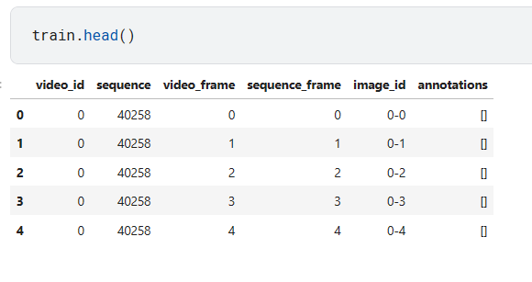
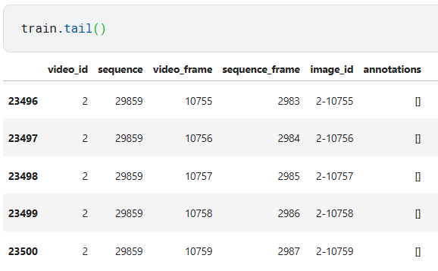
EXPLORING DATASET: train.csv
video_id - ID number of the video the image was part of. The video ids are not meaningfully ordered.
sequence - ID of a gap-free subset of a given video. The sequence ids are not meaningfully ordered.
video_frame - The frame number of the image within the video, there could be occasional gaps in the frame numbers.
sequence_frame - The frame number within a given sequence.
image_id - ID code for the image, in the format '{video_id}-{video_frame}’
annotations - The bounding boxes of any starfish detections in a string format that can be evaluated directly with Python. A bounding box is described by the pixel coordinate (x_min, y_min) of its upper left corner within the image together with its width and height in pixels.

Slide 7
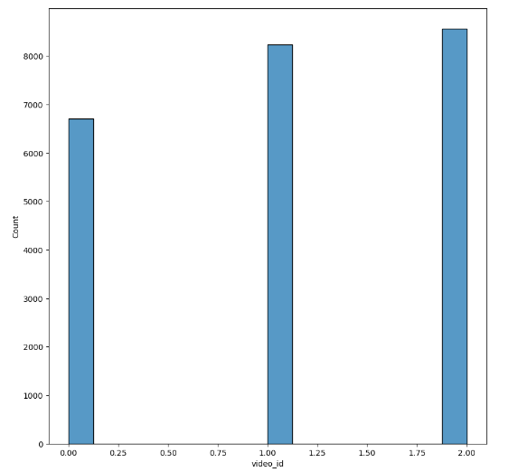
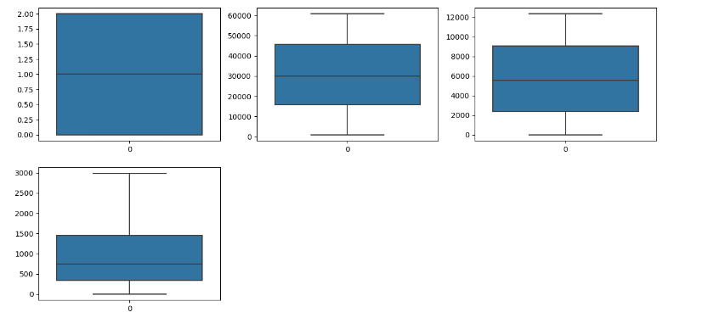
EXPLORING DATASET: distribution
Image distribution per video
Boxplot
There are no outliers that will fit poorly in the model:
no anomaly will badly affect the model
video 0
video 1
video 2

Slide 8
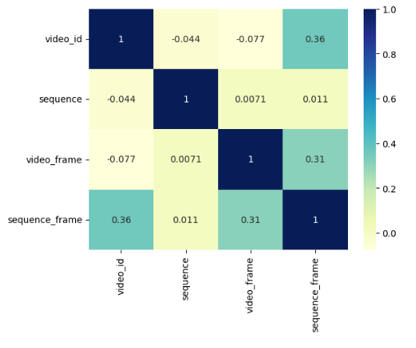
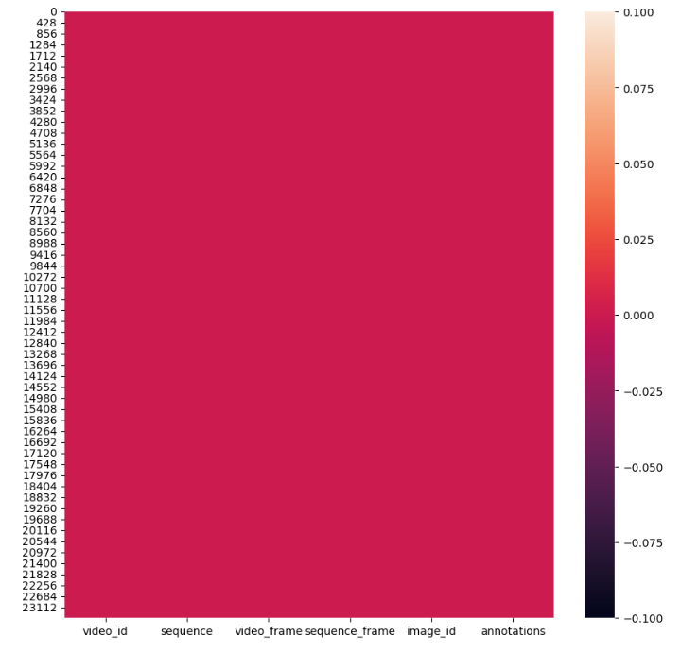
EXPLORING DATASET: cleaning
Correlation Matrix
Null Values
No noticeable correlation detected:
no columns to drop
There is any null value detected

Slide 9
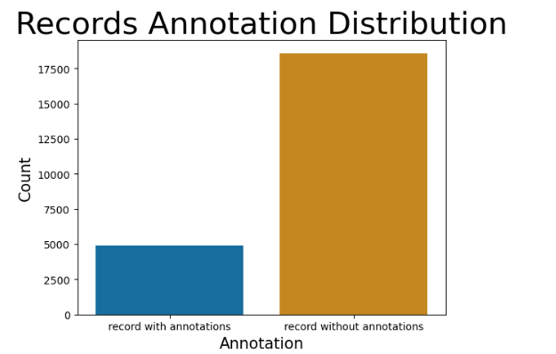
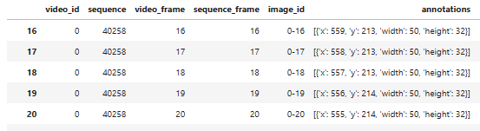
EXPLORING ANNOTATIONS
Annotations have the following format:
[{'x': 645, 'y': 182, 'width': 41, 'height': 45}]
There can be multiple annotations for an image
Not all records contain annotations
Empty annotations are represented just by ‘[]’
They are important for bounding boxes and train the model
Records Annotation Distribution
There are 18582 records without annotations and 4919 records with annotations.

Slide 10
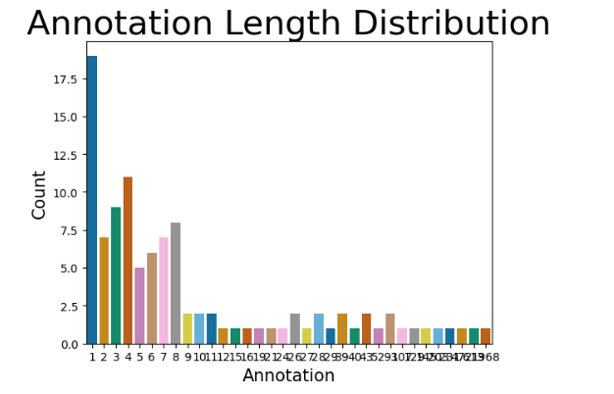
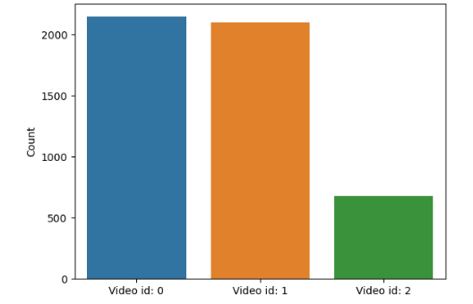
EXPLORING ANNOTATIONS: distribution
Annotation Length Distribution
Annotation Distribution per video
Most records have one or few annotations
The maximum number of annotation for a record is 18
Even if video_2 has the biggest number of images, it shows to be the one with less annotations

Slide 11
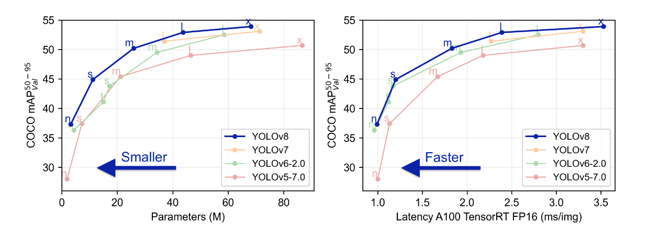
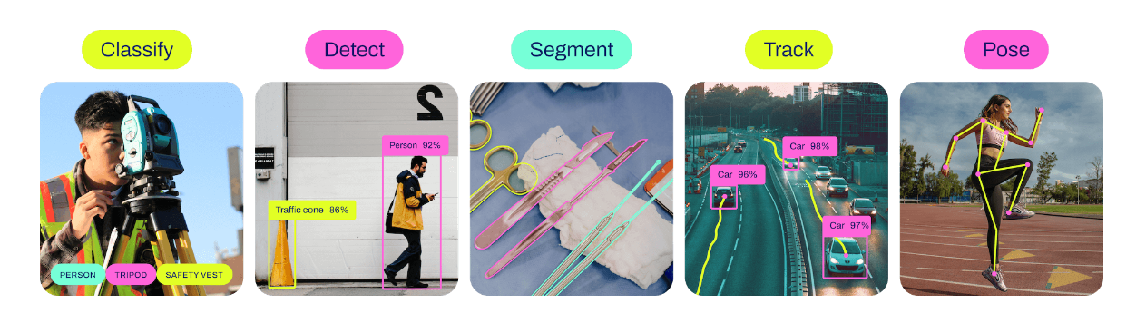
OBJECT DETECTION MODEL: Yolov8
YOLO (You Only Look Once), a popular object detection and image segmentation model first launched in 2015
YOLOv8 is the latest version of YOLO by Ultralytics: new features, improvements for enhanced performance, flexibility, and efficiency.
YOLOv8 supports multiple computer vision tasks: detection, segmentation, classification, and pose estimation.
Ultralytics YOLOv8 supports several modes:
Train: training a YOLOv8 model on a custom dataset.
Val: validating a YOLOv8 model after it has been trained.
Predict: predictions with trained YOLOv8 model on new images/videos.
Export: exporting a YOLOv8 model to a specific format for deployment.
Track: tracking objects in real-time using a YOLOv8 model.
Benchmark: benchmarking YOLOv8 exports speed and accuracy.

Slide 12
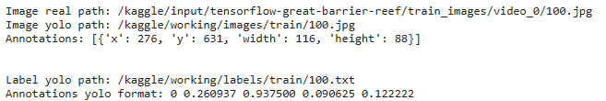
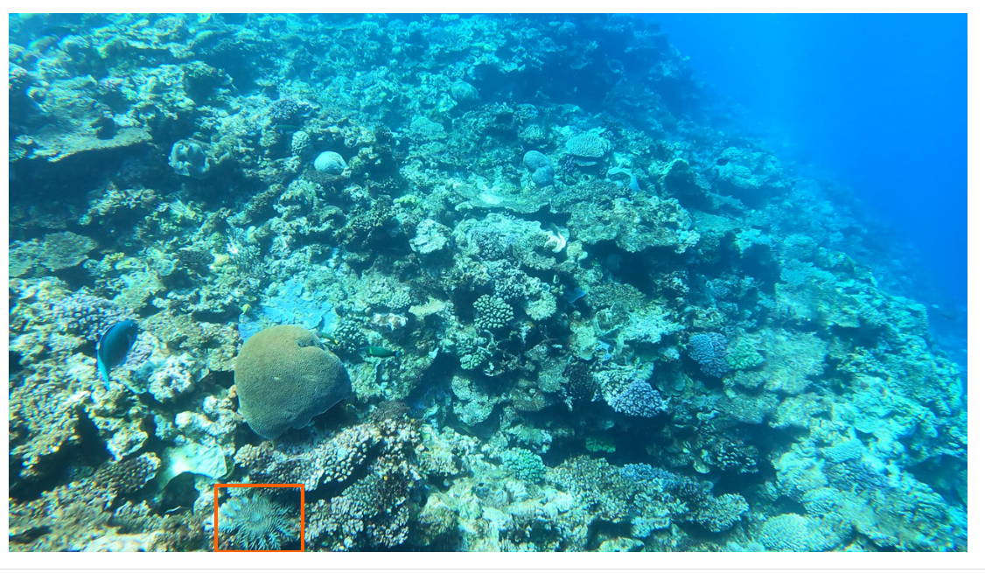
Yolov8: data preparation
To use the model on custom data it needs annotated data with bounding boxes and following setting:
Yolo format annotations
Input directories called «images» and «labels»
images: name_of_image_with_annotation.jpg
labels: name_of_image_with_annotation.txt
bounding box is described by the pixel coordinate from its upper left corner ( x, y, w, h )
( object-class-ID, X center, Y center, Box width, Box height )
4919
create directory local_path/images/train
select only data with annotations
transfer from /train_images to the new directory
create directory local_path/labels/train
write each annotation in a .txt
save in the new directory

Slide 13

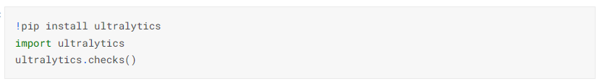
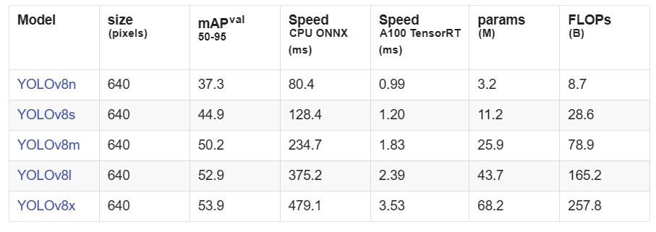
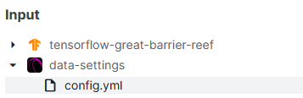
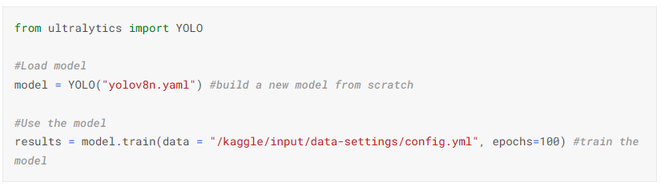
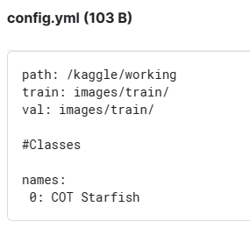
TRAINING THE MODEL
YOLO .yaml file allows to define the dataset root directory ( path ), the relative paths to training/validation/testing image directories and a dictionary of class names ( ID: class_name )
Install Ultralytics
Load and train the model on custom data
YOLOv8 pretrained Detect models are shown here.
Values refer to pretrained models on the COCO dataset.

Slide 14
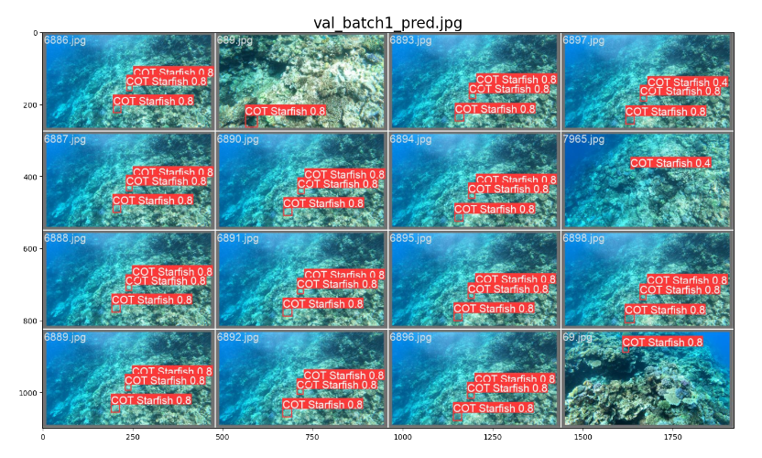
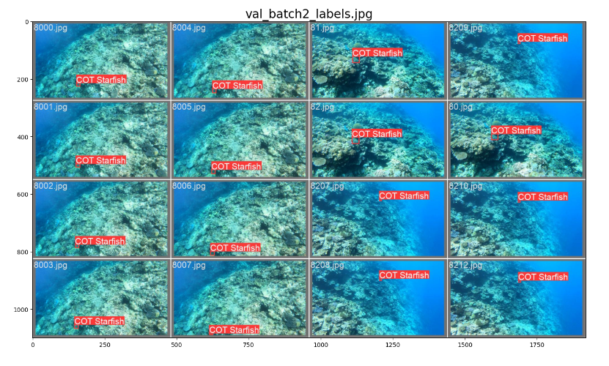
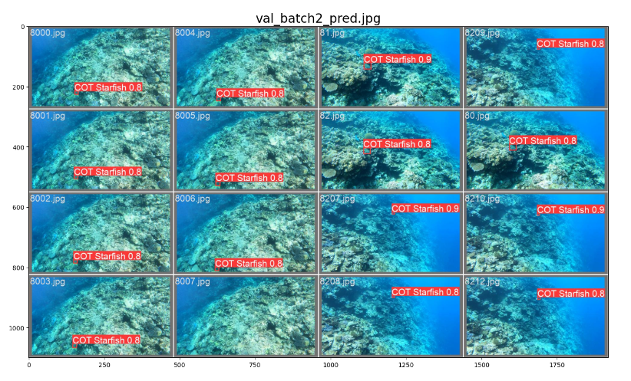
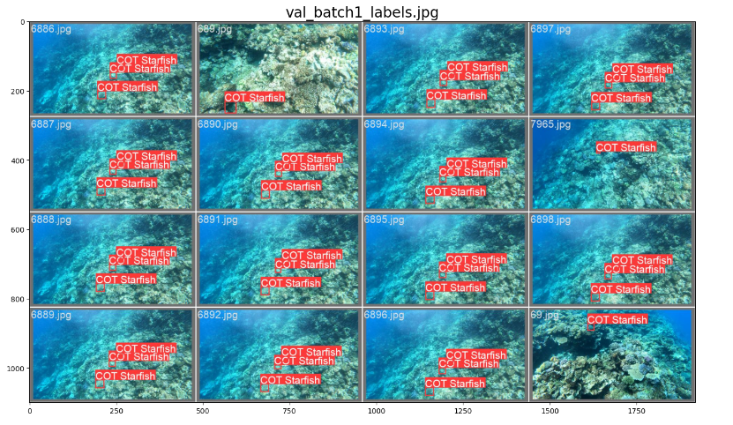
RESULTS: images batch
Specifics:
Kaggle platform - yolov8n model - no agumentation - training for 100 epochs
labels
predictions

Slide 15
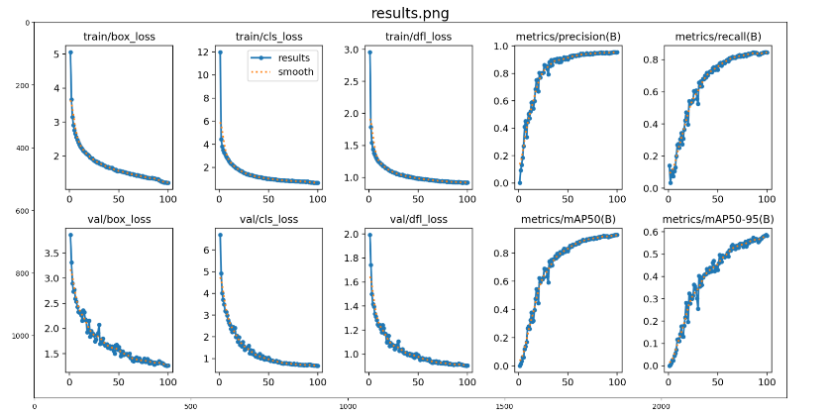
RESULTS: loss, precision, recall, mAP50
mAP50-95:
The mAP50–95 is the mean average precision computed with an IoU of 50%, 55%, 60%, 65%, 70%, 75%, 80%, 85%, 90%, 95% and then averaged.
Less good than the previous one: 0.58
This mean that the model is pretty good at detecting all the COTs in our validation images (mAP50 = 0.93) but is not so good at finding the perfect bounding box (mAP50–95 = 0.58).
Precision:
ratio between the correctly classified Positive samples to the total number of samples classified as Positive.
Good, it goes up to 0.95
Loss:
how well the model is doing for train and val sets. It is a summation of the errors made for each example in training or validation sets.
Good loss curves, they all tend to zero reaching a stability value.
No overfitting or underfitting.
mAP50:
The mAP50 is the mean average precision computed with an IoU of 50% i.e. an aircraft is considered as correctly detected is 50% of the ground truth bounding box is covered by the predicted bounding box.
Good, it reaches 0.93
Recall:
ratio between the correctly classified Positive samples to the total number of actual Positive samples
Quite good, it goes up to 0.85

Slide 16
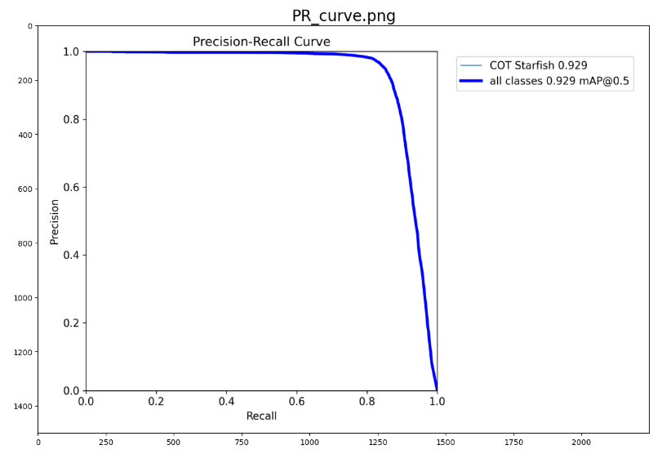
RESULTS: precision-recall curve
The precision and recall curve depicts the tradeoff between precision and recalls for various thresholds:
A high area under the curve indicates both high recall and high precision.
If the scores are high for both, it indicates that the classifier is yielding accurate findings (high accuracy) and a majority of all positive results (high recall).
A perfect model is shown at the point (1, 1), indicating perfect scores for both precision and recall.
Good model: mAP of 0.929
It correspond to the area under the curve

Slide 17
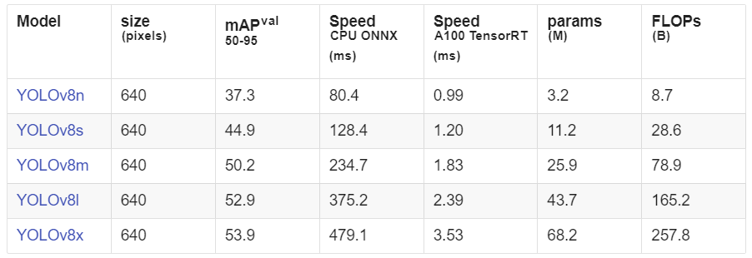
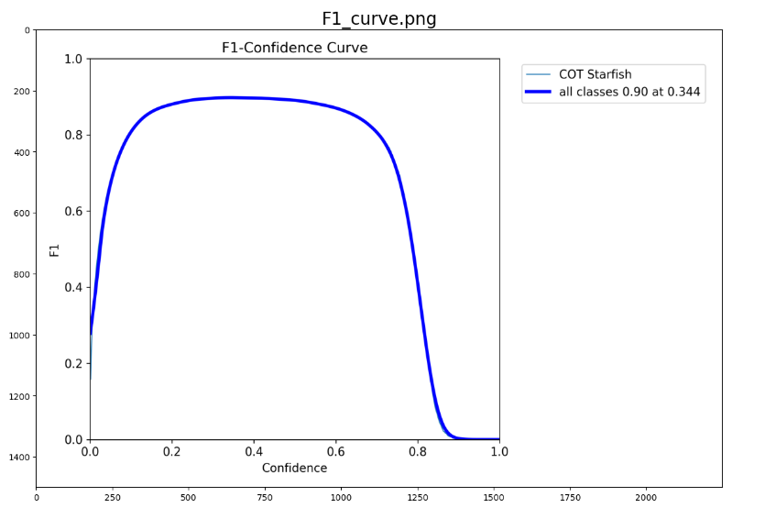
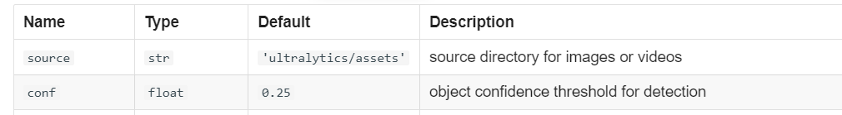
COMMENTS
No actual evaluation of the model:
No validation set
No test set
To improve the model many things can be tried:
training with other Yolov8 versions
augumentaton (using Yolo settings or self made functions)
setting confidence threshold by evaluating F1 curve

Slide 18
USEFUL LINKS
- yolov8
- kaggle
- github

